Slide 1
LD Database
GICS(IndustryID, IndustryTitle, Level, Description, ParentID)
CLASSIFY(IndustryID, CompanyID)
COMPANY(CompanyID, Address, ZipCode, Street, City, IndustryGroup, SubIndustry, Website).
HIRE(CompanyID, PositionCode)
POSITION(PositionCode, Title, Description, PayRangeHigh, PayRangeLow)
JOB(JobCode, PositionCode, EmployeeMode, {RequiredSkill}, PayRate, PayType, CategoryCode, Company, Wage, Salary, Full-time, Part-time)
REQUIRES(PositionCode, SkillCode)
SKILL(SkillCode, Title, Description, Level)
WORKS(PersonID, JobCode, StartDate, EndDate)
REQUIRES BY JOB(SkillCode, JobCode)
TAKES(PersonID, CourseCode, SectionNo, CompletionDate)
PERSON(PersonID, Name, Address, ZipCode, Street, City, Email, Gender, Phone)
SECTION(CourseCode, SectionNo, CompletionDate, Year, OfferedBy, Format, Price)
HAS SKILL(SkillCode, PersonID)
COURSE(CourseCode, Title, Level, Description, Status, RetailPrice)
TEACHES(CourseCode, SkillCode)
PREREQUISITE(CourseCode, RequiredCode)

Slide 2
AZ Database
STORE(StoreID, Address, ZipCode, Phone)
STOCKS(StoreID, ItemNum)
INVENTORY(ItemNum, Title, Description, Quantity, Unit, AvgCost, ShelfCode, MinLevel)
SALE(InvoiceNbr, Date, ItemNbr, Quantity, Price, Note, MinLevel)
PURCHASE(PurchaseNbr, Date, ItemNbr, Quantity, UnitCost, Note)

Slide 3
GV Database
FACTORY(FacotryID, FactoryName, Address, ZipCode, Phone, Manager)
MAKES(FactoryID, ProductCode, Quantity)
PRODUCT(ProductCode, ProductName, Description, Quantity, Unit, AvgCost)
SEARCH(FactoryID, MaterialCode)
LINEITEM(ContractID, ProductCode, Quantity)
CONTRACT(ContractID, CustomerID, Date, SaleAmount, PaySchedule)
CUSTOMER(CompanyID, ContactPerson, ContactEmail)
MATERIAL(MaterialCode, MaterialName, Quantity, Unit, MinLevel)
PURCHASELINE(PurchaseNum, MaterialCode, Quantity)
PURCHASE(PurchaseNum, SupplierID, SupplierOrderNum, BookDate, PayDate, Note)
SUPPLIER(CompanyID, Website, ContactEmail)

Slide 4
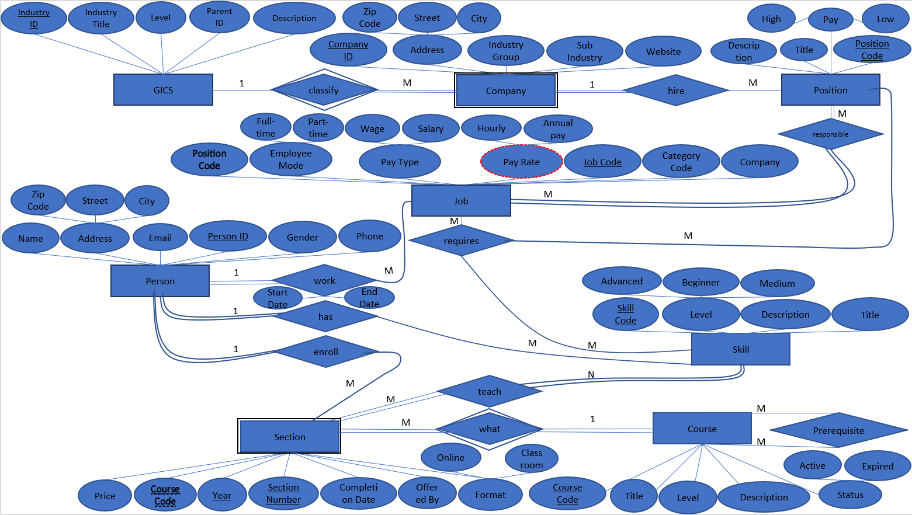
M
M

Slide 5
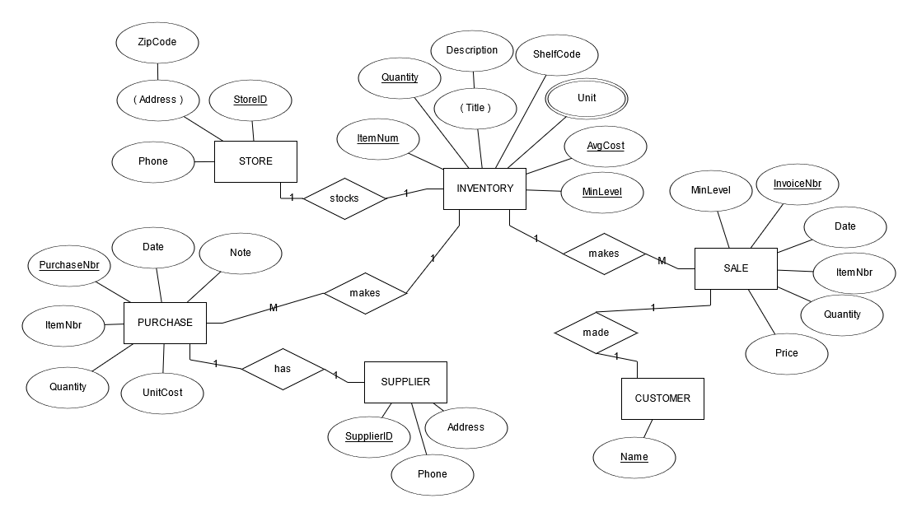
AZ

Slide 6
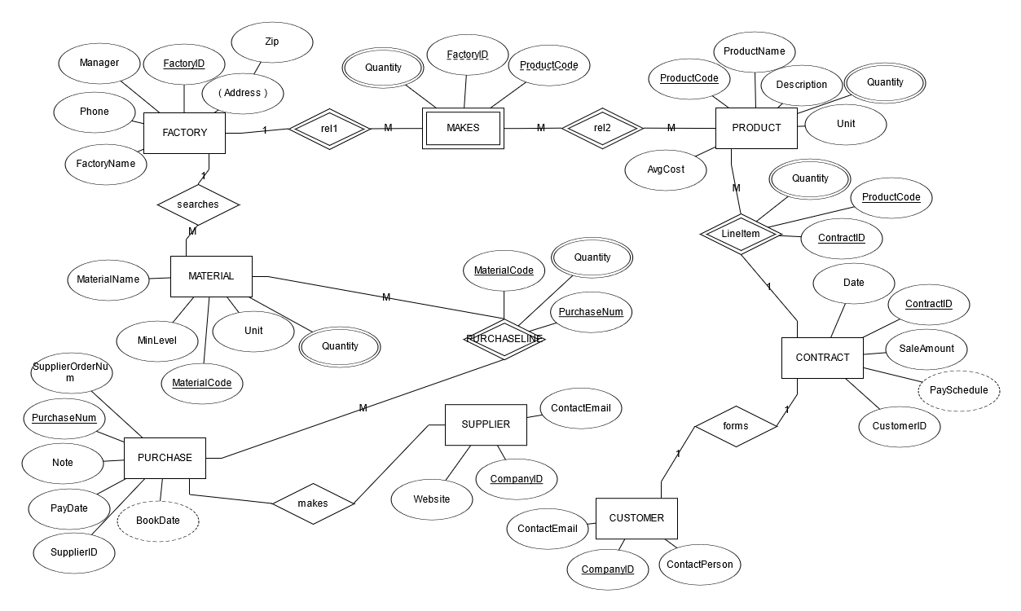
GV

